Slide 1

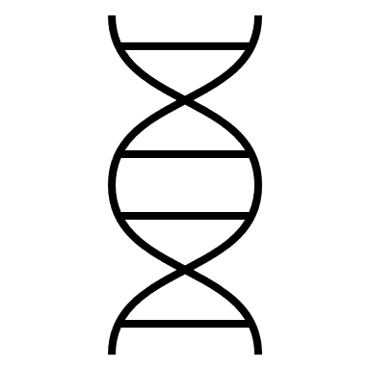
Mutations
MOLECULAR GENETICS LABORATORY BT344 Experiment (3)

Slide 2
What Are Mutations?
Changes in the nucleotide sequence of DNA
May occur in somatic cells (aren’t passed to offspring)
May occur in gametes (eggs & sperm) and be passed to offspring

Slide 3
Normal protein
Normal or WT gene
DNA
WT phenotype
Mutated gene
Mutant phenotype
DNA
Mutant protein

Slide 4
Are Mutations Helpful or Harmful?
Some mutations may improve an organism’s survival (beneficial)
Protein-coding DNA can be divided into codons
Codons: are sets of three bases that specify an amino acid or signal the end of the protein.
In the example at right, GCA for guanine, cytosine, and adenine.

Slide 5
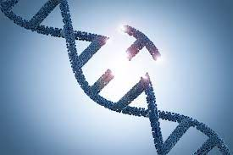
Types of Gene Mutations
Point Mutations
- Substitutions
- Insertions
- Deletions
2. Frameshift Mutations
- Insertions
- Deletions

Slide 6
1. Point Mutations
Change of a single nucleotide
Includes the deletion, insertion, or substitution of ONE nucleotide in a gene

Slide 7
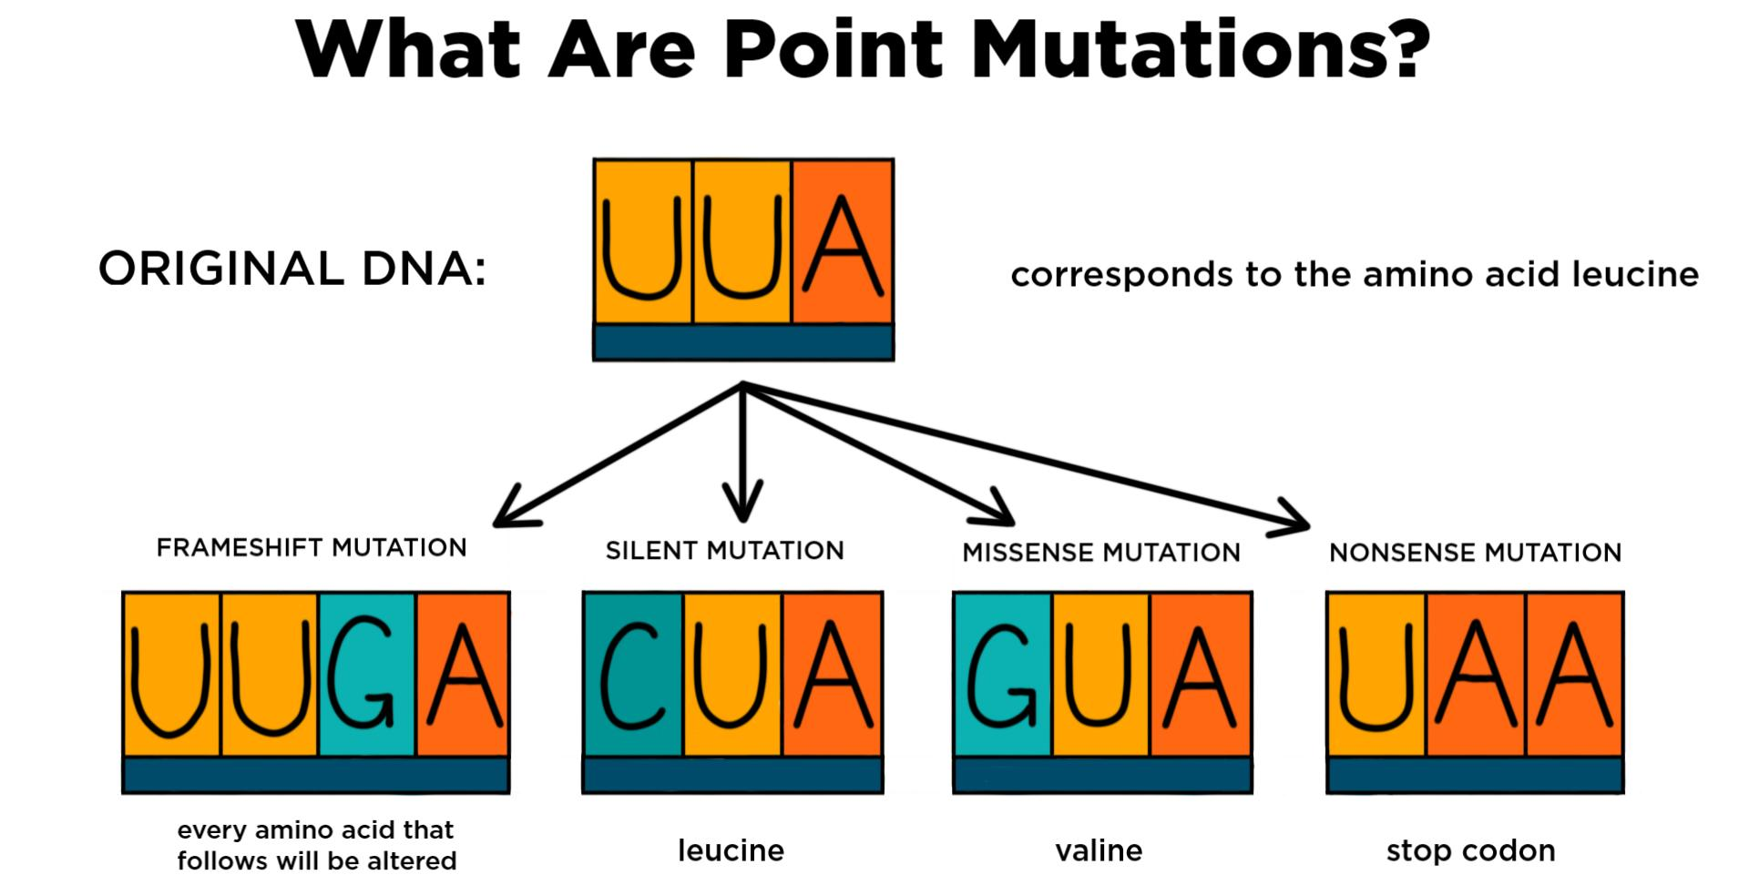

Slide 8
2. Frameshift Mutations
Inserting or deleting one or more nucleotides – a specific type of point mutation that can change the created protein.
Changes the “reading frame” like changing a sentence
Proteins built incorrectly

Slide 9
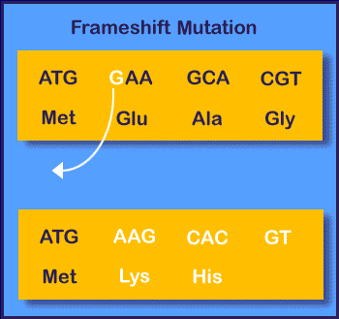
Amino Acid Sequence Changed

Slide 10
(Effect on protein encoded)
Missense mutations
Sense mutations
Nonsense mutations

Slide 11
Missense mutations
– Single nucleotide change that changes one amino acid for another
• Sense mutations
– Produce longer or shorter proteins by changing a termination codon into one that codes for an amino acid
• Nonsense mutations
– Change of a codon for an amino acid into a termination codon shortens the protein product

Slide 12
Substitution mutations
A mutation that exchanges one base for another.
Substitution could: (Effect on protein encoded)
Missense mutations
Sense mutations
Nonsense mutations

Slide 13




Base-pair substitution mutations
Transition
Pur Other Pur Pyr Pyr
A
T
G C
Transversion
Pyr Pur
Pur Pyr
A
T
T A

Slide 14
Deletion and insertion mutations
Insertion: Extra base pairs are inserted into a new place in the DNA (cause a frameshift).
Deletion : Section of DNA is lost or deleted (cause a frameshift).

Slide 15




Effect on protein encoded
Missense mutation
bp mutation in DNA results in change in mRNA codon, so that a different amino acid is inserted at that site in the protein.
DNA RNA
Protein
AAA AAA
GAA GAA
lysine
glutamic acid
Single nucleotide change in codon 6 (glu to val) of β-globin gene leads to mutant form of hemoglobin and sickle cell anemia.

Slide 16
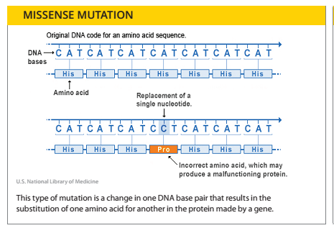
Missense mutations

Slide 17
Nonsense mutation
bp change in DNA results in change in mRNA codon to a STOP codon, so that translation is terminated.
DNA
AAA
TAA
RNA
Protein
AAA
UAA
lysine
STOP
Truncated polypeptide

Slide 18
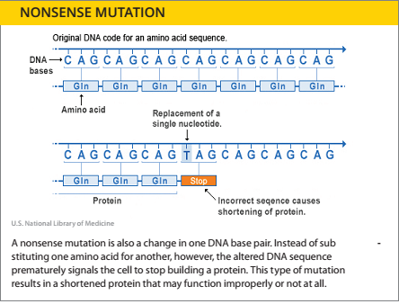
Nonsense mutations:

Slide 19
Silent mutation
bp change in DNA results in change in mRNA codon, so that the SAME aa is inserted.
DNA
AAA
AAG
RNA
Protein
AAA
AAG
lysine
lysine
No effect.

Slide 20
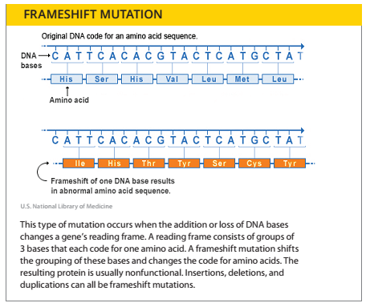
Frameshift Mutation:

Slide 21
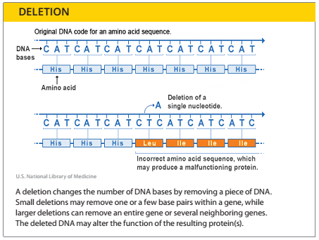
Deletion Mutation

Slide 22
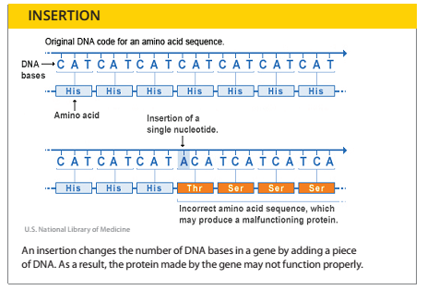
Insertion Mutation

Slide 23
Mutations may be:
– Spontaneous: as a result of errors in DNA replication or
– Induced: by exposure to radiation, chemicals, viruses, or other mutagenic agents

Slide 24
The causes of mutations
Mutagenesis: is the process by which mutations are induced. It may occur spontaneously, or as a result of exposure to mutagens.
1. DNA fails to copy accurately (Spontaneous mutations)
2. External influences (Induced mutations)

Slide 25
The causes of mutations
2. External influences (Induced mutations)
Radiation (physical mutagen)
- UV (from sunlight)
- X-ray (medical uses)
Chemicals (chemical mutagen)
- Carcinogens (e.g. cigarette)
- Cosmetics and cleaning products
- Proceed foods and preservative
- DNA intercalating agents (e.g. ethidium bromide, yellow and red acridine dyes)

Slide 26
The causes of mutations
Infectious agent ( biological mutagen)
- Viruses (e.g., HPV)
- Bacteria (e.g., Helicobacter)

Slide 27
Effect of Chemicals
Chemicals can cause mutations in a number of ways
• Base analog – may change pairing
• Chemical modification – mutagens change one base into another
• Intercalating agents – alter the shape may cause deletion or addition

Slide 28
Radiation (physical mutagen)
• Ionizing radiations:
(Penetrative/very high energy/short wavelengths):
X-rays
Gamma rays
Alpha particles
They energize electrons, causing them to leave atoms and molecules, forming highly reactive ions.
This can cause DNA molecules to break down and triggers mutations.

Slide 29
Radiation (physical mutagen)
• Nonionizing radiation:
(Not penetrative/lower energy/longer wavelength) such as:
UV-light (wavelength above 260 nm).
Causes the breaking of bonds between purines and Pyrimidines when two pyrimidine molecules of the same type (T or C) are adjacent to one another on a nucleoside.
These pyrimidine dimers distort the sugar phosphate backbone and prevent proper replication and transcription.

Slide 30
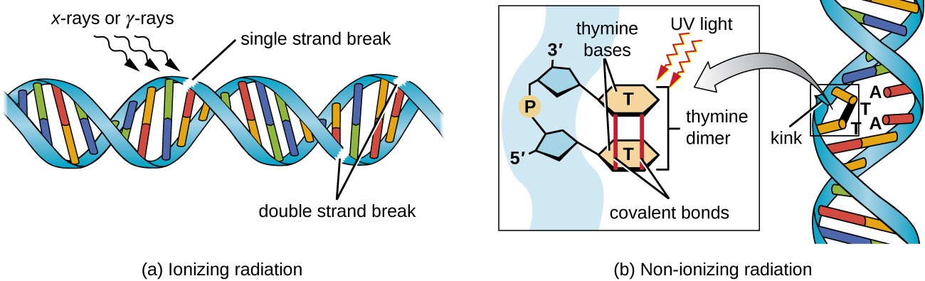

Slide 31
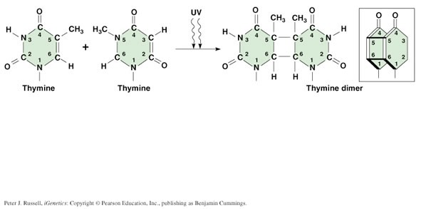

Slide 32
Effect of UV light on bacterial survival
Mutations occur naturally in bacteria at a rate (10⁻⁷– 10⁻⁸ ) per base pair during one round of replication.
In the presence of a mutagen, however this rate can increase dramatically.
Ionizing radiation, such as x-rays or gamma radiation carries enough energy to remove electrons from molecules in a cell. When electrons are removed from molecules, ions called free radicals are formed.
Free radicals can damage most other molecules in a cell, such as DNA or RNA, by oxidizing them.

Slide 33
Effect of UV light on bacterial survival
Non-ionizing radiation, such as ultraviolet (UV) light, exerts its mutagenic effect by exciting electrons in molecules.
The excitation of electrons in DNA molecules often results in pyrimidine dimer formation.
These dimers often change the shape of the DNA in the cell and can cause problems during replication.
The cell often tries to repair pyrimidine dimers before replication, but the repair mechanism can also lead to mutations as well.

Slide 34
Effect of UV light on bacterial survival
Most microorganisms have mechanisms which can repair damage to the DNA strands caused by UV light. Of these repair mechanisms are photoreactivation, excision (dark) repair and post-replication recombination.
Humans with xeroderma pigmentosum are quite defective in thymine dimer repair, because of a mutation in the gene encoding the endonuclease enzyme, and thus are very prone to skin cancer.

Slide 35
Effect of UV light on bacterial survival
Photoreactivation is carried out by an enzyme called photolyase that binds to the dimers. In the presence of visible light, photolyase breaks the bond between the partners of the dimer and returns the damaged DNA strand to its original state.
In dark repair (excision) enzymes called nucleases hydrolyze the damaged portion of the DNA template so that other enzymes can re-synthesize the original DNA in that region, replacing the thymine dimers with two normal thymine molecules, thus restoring the DNA to its original state.

Slide 36
Effect of UV light on bacterial survival

Slide 37
Procedure#1 (UV resistant and sensitive bacteria)
You will be supplied with two strains of bacteria; one strain is UV resistant (E. coli) and the other is UV sensitive, or called UVR-- (Salmonella typhimurium).
• Using a permanent marker, divide the agar plate into 4 quarters (One half will be exposed to UV light ,and the other half will be covered with the plate lid (control)
• Using a sterile loop, streak a loop-full of E. coli broth on the (E) area, and a loop-full of Salmonella broth on the (S) area.

Slide 38
Procedure (UV resistant and sensitive bacteria)
Turn off the room lighting.
Cover one half with the plate lid and expose the other half to UV light for 30 seconds.
Place the plate inverted in the incubator at 37º C for 24 hours.
Then, you can decide which strain is sensitive and which is resistant.
*** Don't forget to work under aseptic conditions

Slide 39
Procedure #2 (Ames test)
A bacterial strain is defined as an auxotroph if it is unable to produce a required nutrient and thus will not grow unless the nutrient is supplied in growth media.
Auxotroph are usually produced as a result of a mutation(s) that occurs in a prototroph (a bacterium that can synthesize the nutrient).

Slide 40
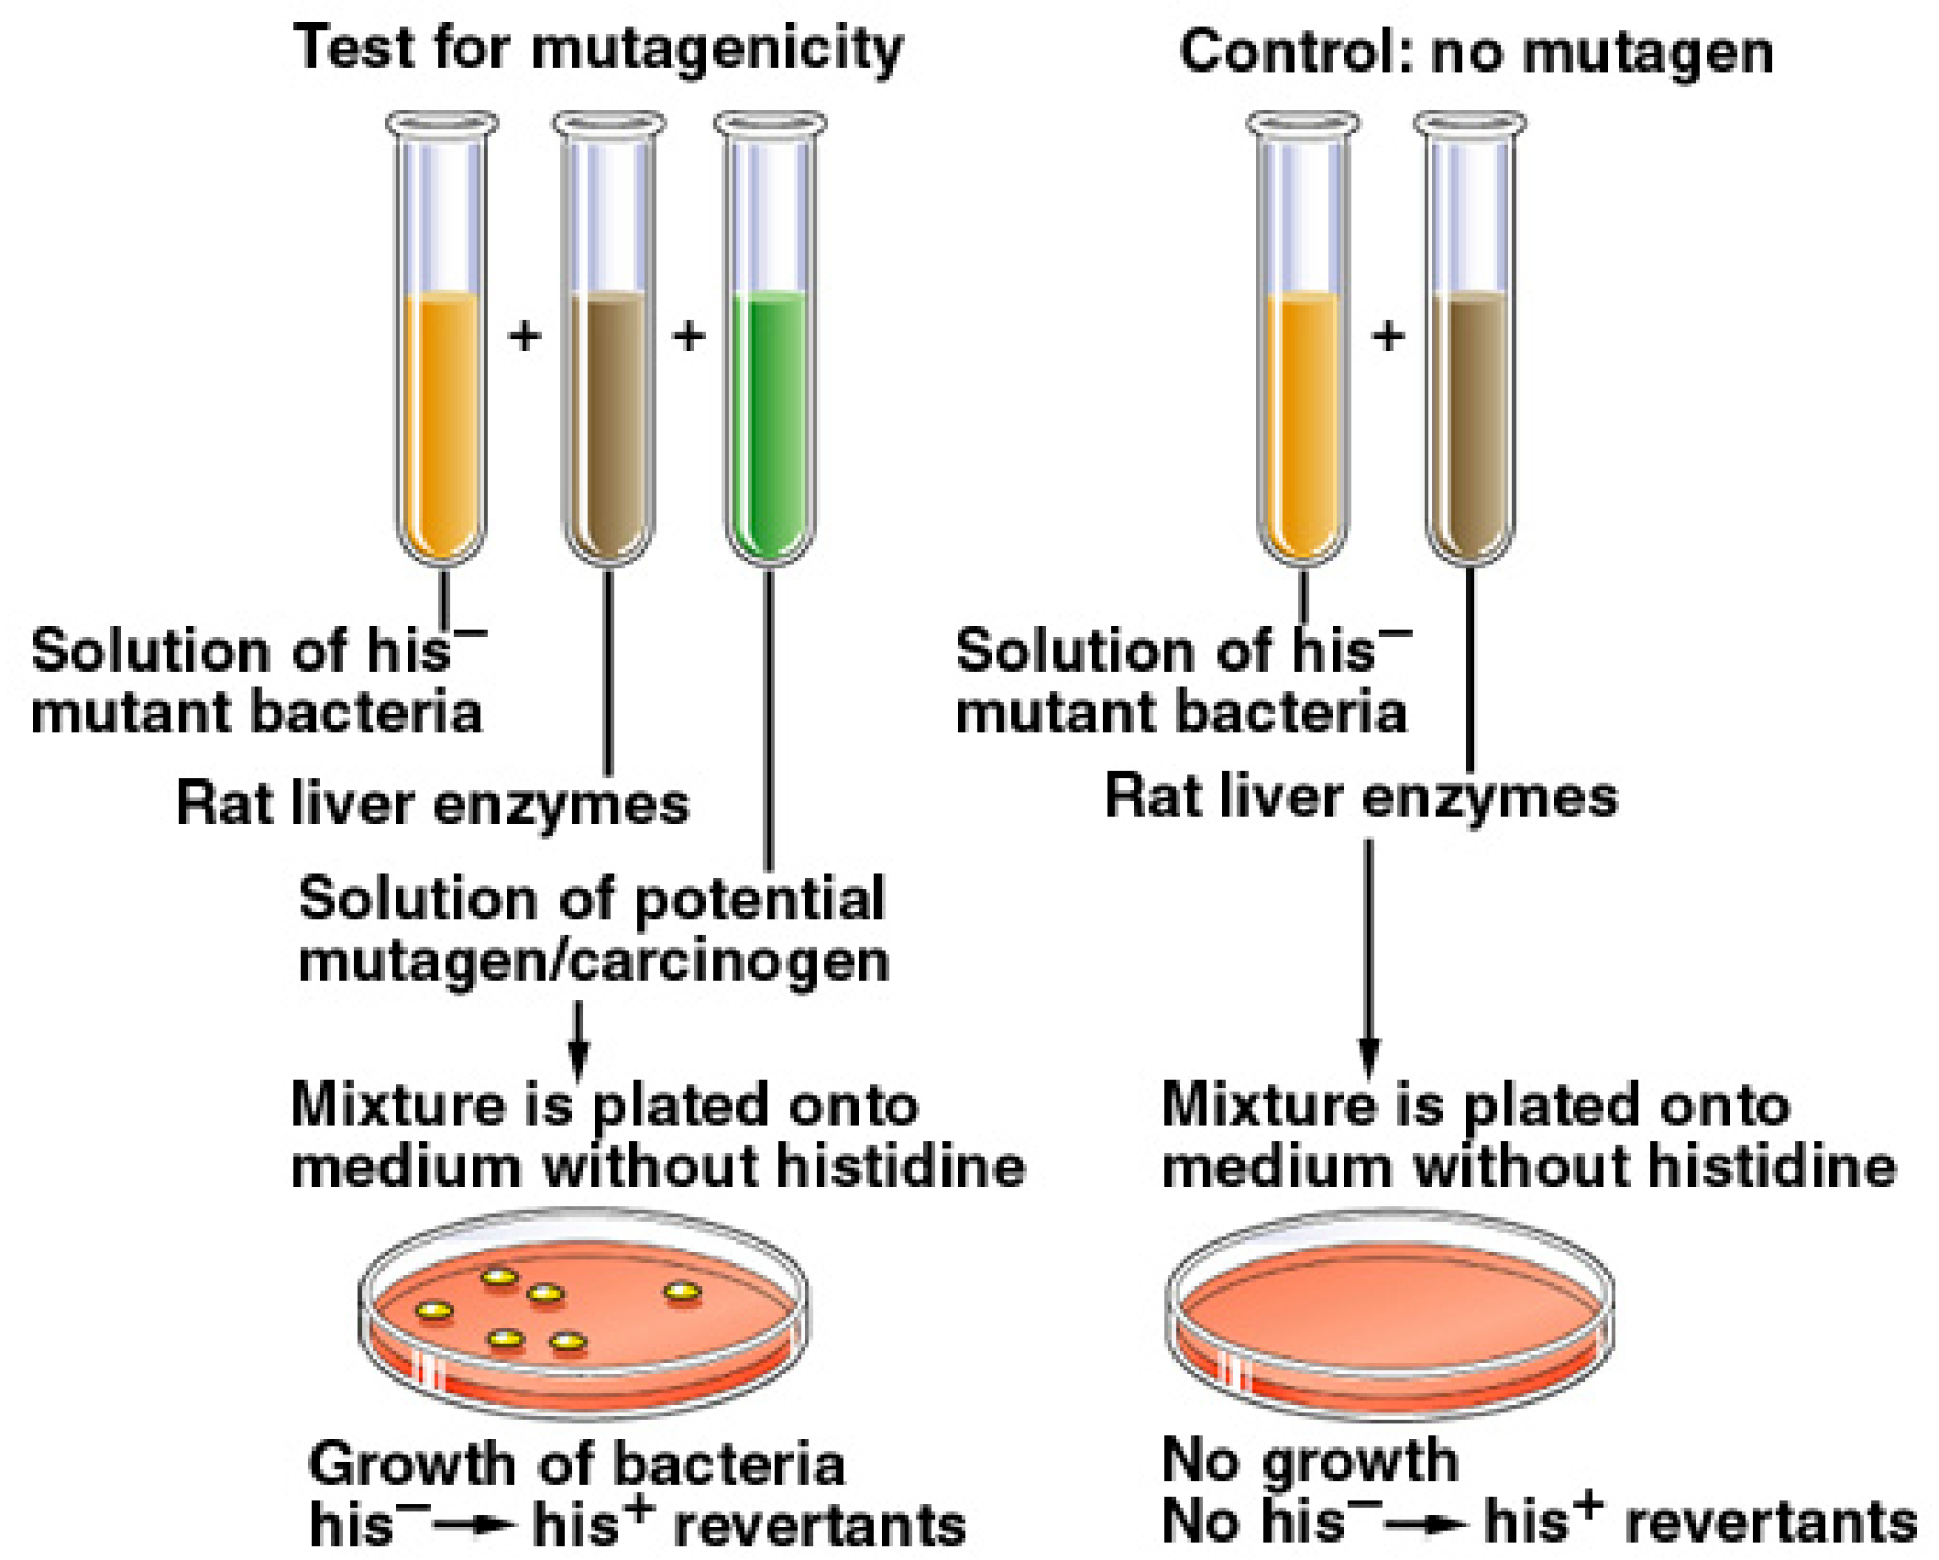

Slide 41
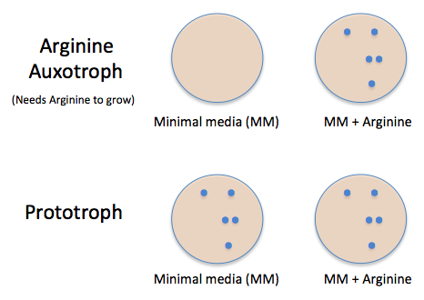

Slide 42
Procedure #2 (Ames test)
Specific strains of bacteria Salmonella typhimurium are known as auxotroph are used in this experiment. (the test organism in this experiment cannot synthesize the amino acid histidine) and thus will not grow unless the nutrient (His) is supplied in growth media.
The mutant S. typhimurium strains TA1535 and TA1538 (and others) are histidine auxotroph (denoted his- in order to distinguish it from the original his+ prototrophic strain they were derived from) due to a mutation in a gene encoding an enzyme required for histidine biosynthesis (pathway).

Slide 43
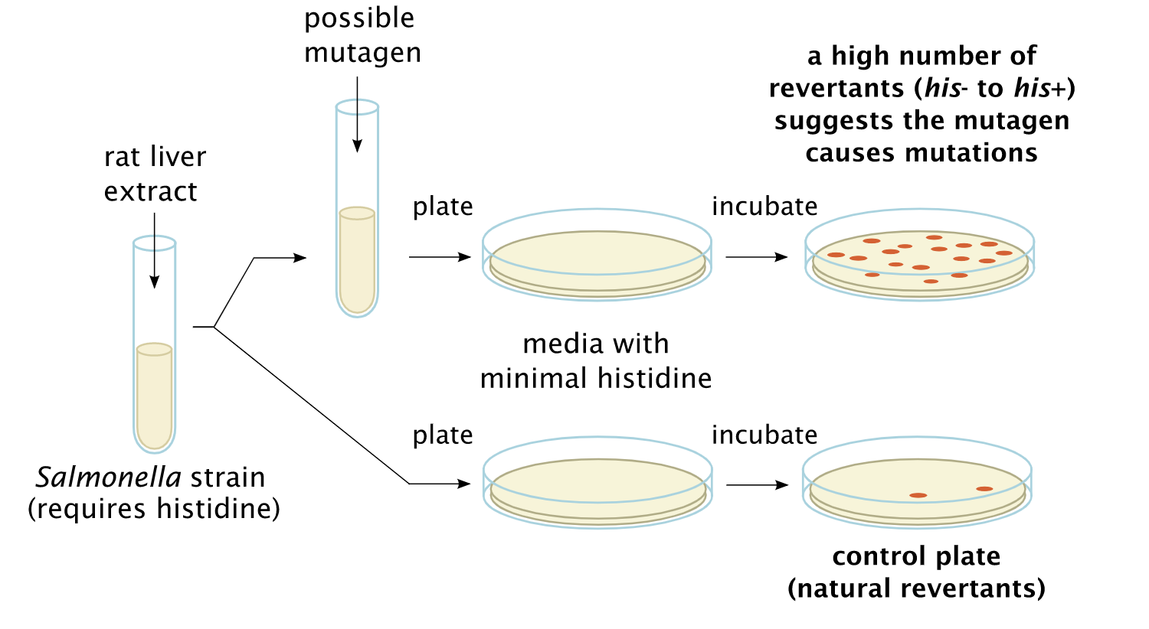

Slide 44
Procedure #2 (Ames test)
The bacteria are spread on an agar plate with small amount of histidine.
This small amount of histidine in the growth medium allows the bacteria to grow for an initial time and have the opportunity to mutate (reversion).
When the histidine is depleted only bacteria that have mutated to gain the ability to produce its own histidine will survive.
The plate is incubated for 48 hours.
The mutagenicity of a substance is proportional to the number of colonies observed.

